Slide 1


Faculty Development Program
On
ARTIFICIAL INTELLIGENCE & MACHINE LEARNING
5th – 9th February
Introduction to Neural Network and Deep Learning
By
Dr. Sibarama Panigrahi
Senior Member, IEEE
Assistant Professor, Department of Computer Sc. & Engineering
National Institute of Technology, Rourkela, Odisha, 769008, India
Mobile No.: +91-7377302566
Email: panigrahis[at]nitrkl[dot]ac[dot]in
panigrahi[dot]sibarama[at]gmail[dot]com

Slide 2
Outlines
Introduction to Neural Network
Introduction to Neural Network
Mathematical Model for Neural Network
Differentiation and its Application to Train Neural Network
Deep Neural Network
Recent Advances in Deep Learning
Activation Function, Weight Initialization (Xavier & Glorot, He)
Dropout and Regularization, Batch Normalization
Optimizers (SGD, NAG, AdaGrad, AdaDelta, RMSPROP, ADAM)
Building and Training Deep Neural Network using Python
Introduction to Hyper-Parameter Optimization
Block Diagram of Bio NS

Slide 3
Artificial Neural Network
Introduction to Neural Network
An Artificial Neural Network (ANN) is a mathematical model that loosely simulates the structure and functionality of Biological nervous system to map the inputs to outputs.
Block Diagram of Bio NS

Slide 4
Block Diagram of Biological Nervous System
Introduction to Neural Network
Receptors
Neural
Network
Or
Brain
Effectors
Stimulus
Response
Typical Human Brain
Notes:
The Receptors converts the stimuli from external environment or human body into electrical impulses that convey information to neural net.
The neural net or brain continuously receive information , perceive it and makes appropriate decession.
Two types arrows present in the system(Feed forward and feed back)
The receptors convert electrical impulses from neural net into descernible responses as system output.

Slide 5
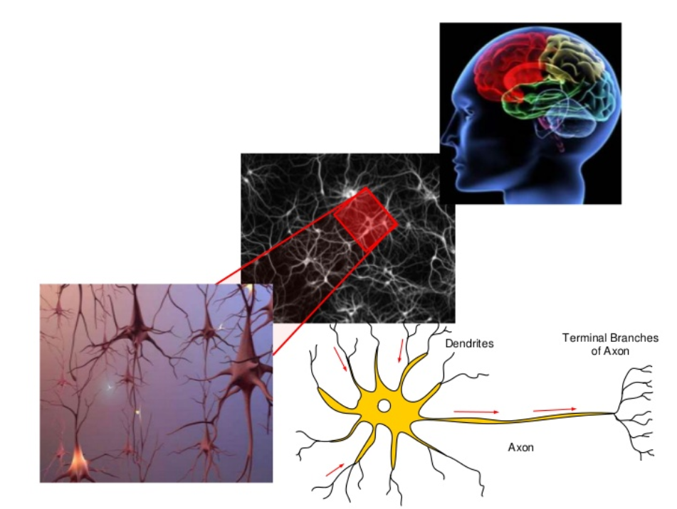
Typical Human Brain
Introduction to Neural Network
Cell Body
Human Neuron vs Art Neuron

Slide 6
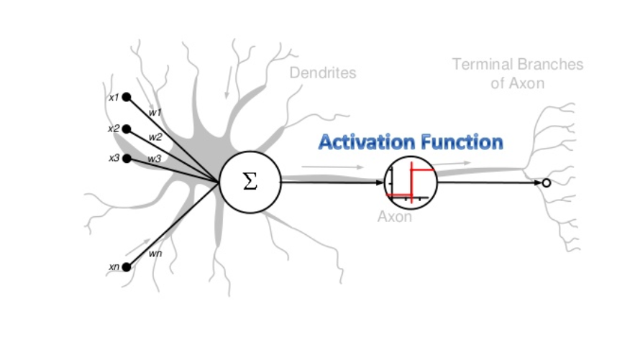
Human Brain Neuron vs Artificial Neuron
Introduction to Neural Network
Artificial Neuron

Slide 7
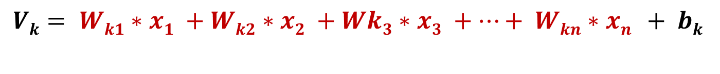
Artificial Neuron
Introduction to Neural Network
x₁
b_{k}
W_{k1}
x₂
W_{k2}
∑
W_{k3}
V_{k}
x₃
:
:
:
W_{kn}
K^{th} Neuron
x_{n}
$$Vk= Wk1∗x1 +Wk2∗x2 +Wk3∗x3 +…+ Wkn∗xn + bk$$
Artificial Neuron

Slide 8


Artificial Neuron
Introduction to Neural Network
x₁
b_{k}
W_{k1}
x₂
W_{k2}
∑
V_{k}
Activation Function
x₃
W_{k3}
y_{k}
:
:
:
W_{kn}
K^{th} Neuron
x_{n}
$$Vk= \sum_{j=1}^{n}{(Wkj∗xj) + bk}$$
$$yk= f(Vk)$$
Single Neuron with Single i/p

Slide 9
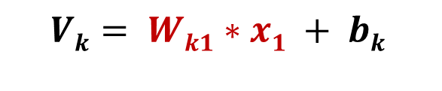
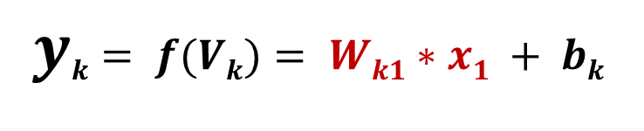
Single Neuron Model
Introduction to Neural Network
b_{k}
Output is Linearly Dependent on Input Parameters
∑
W_{k1}
V_{k}
x₁
y_{k}
$$Vk= Wk1∗x1 + bk$$
$$yk= f(Vk)= Wk1∗x1 + bk$$
Data Fitting Application

Slide 10
Single Neuron Model
Introduction to Neural Network
Application
For data Fitting applications where we have to fit a straight line to a large data set.
y=mx+c
Where m=Slope Of Straight Line
X=Height c=Intercept y=Weight
W
E
I
G
H
T
vcv
Height
Error Calculation

Slide 11

Single Neuron Model
Introduction to Neural Network
Single Neuron Model
Error Calculation
The error E_{i}=(Actual Value – Predicted value)=$(Ti−yi)$
For making +ve= $Ei= (Ti−yi)2$[Error for i^{th} input instance]
W
E
I
G
H
T
vcv
Height
Why error Calculation?

Slide 12
Linear Neural Network
Introduction to Neural Network
Error Calculation
It is done to adjust the slope(m) and intercept for better fitting next time.
W
E
I
G
H
T
Height
Equivalence of Data Fitting&ANN

Slide 13
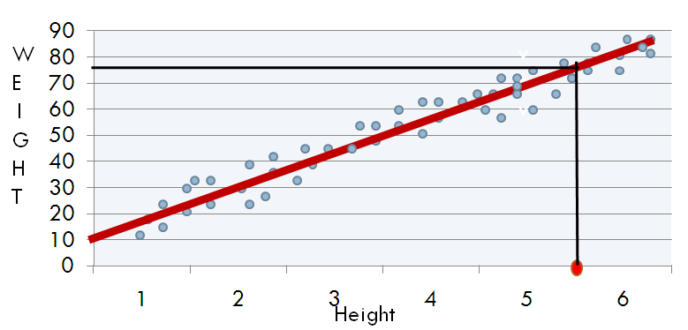
Linear Neural Network
Introduction to Neural Network
y_{k}= W_{k1}*x₁ + b_{k}
y=m*x+c
b_{k}
Output is Linearly Dependent on Input Parameters
∑
W_{k1}
V_{k}
x₁
y_{k}
V_{k}= W_{k1}*x₁ + b_{k}
y_{k}= f(V_{k})= W_{k1}*x₁ + b_{k}
Plotting the Error.

Slide 14
Plotting Error
Introduction to Neural Network
Error →
W_{k1} →
b_{k} →
Differentiation Intuitive meani

Slide 15

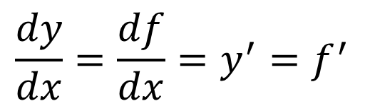




Differentiation…
Introduction to Neural Network
$$y=f(x)$$
How much does y change as x changes=
$$y=f(x)$$
y₂
(x2,y2)
$$\frac{dy}{dx}=\frac{df}{dx}=y^{′}=f^{′}$$
(x1,y1)
$$θ$$
y₁
$x$ ------→
x₁
x₂
$$\frac{dy}{dx}=\lim_{Δx→0}{\frac{Δy}{Δx}}$$
What happens in Differentiation

Slide 16




Differentiation…
Introduction to Neural Network
$$\frac{dy}{dx}=\lim_{Δx→0}{\frac{Δy}{Δx}}$$
As $Δx →0$ we obtain a
tangent at x.
$\frac{dy}{dx}=tan(θ)$=slope of the tangent at x=x₁
$\frac{dy}{dx}=$ Slope of the tangent to x-axis at x=x₁
$$y=f(x)$$
y₂
y₁
$$θ$$
$x$ →
x₁
x₂
Different cases of angle theta

Slide 17
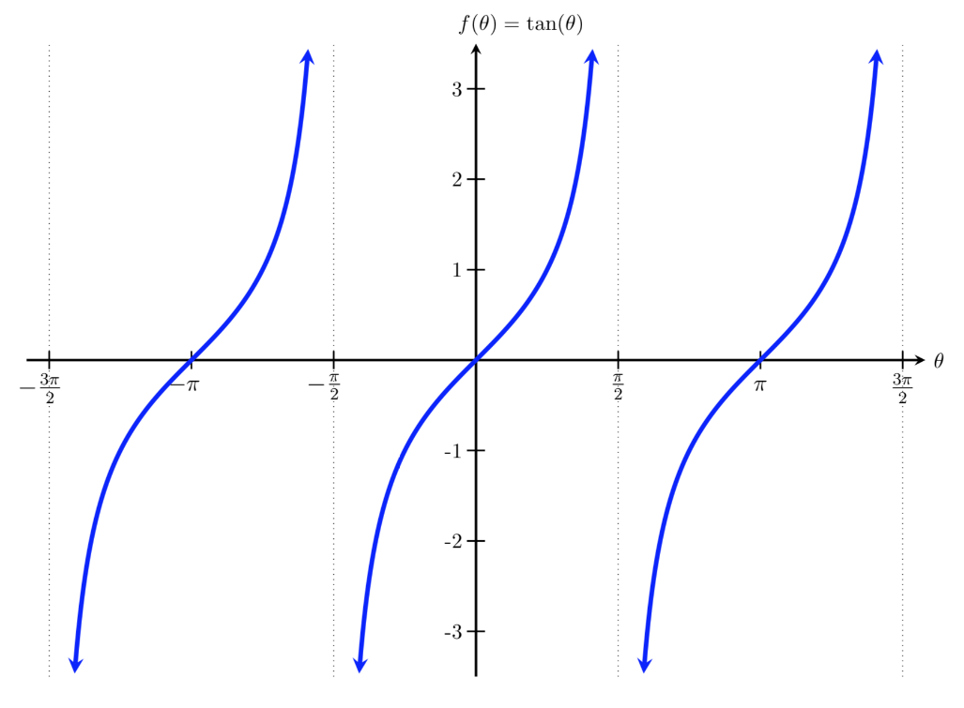

Differentiation…
Introduction to Neural Network
$0<θ<90 tan(θ)$= +ve
90 tan(90)=Undefined
$$y=f(x)$$
$$θ$$
$x$ →
x₁
When theta > 90

Slide 18



Differentiation…
Introduction to Neural Network
$θ>90 tan(θ)$= - ve
$$y=f(x)$$
$$θ$$
$x$ →
x₁
When theta=0

Slide 19

Differentiation…
Introduction to Neural Network
$θ=0 tan(θ)$= 0
$$y=f(x)$$
$x$ →
x₁
Maxima and Minima

Slide 20
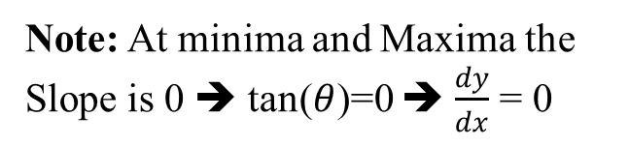
Differentiation…
Introduction to Neural Network
$θ=0 tan(θ)$= 0
$$y=f(x)$$
Maxima
$x$ →
x₁
Minima
Note: At minima and Maxima the Slope is 0 ➔ tan($θ$)=0 ➔ $\frac{dy}{dx}$ = 0
Distinguishing b/w maxi & Mini

Slide 21

Differentiation…
Introduction to Neural Network
Distinguishing between a Minima & Maxima
Let f(x)= X² - 3X + 2
$\frac{df}{dx}$ =0
2X -3 =0
X=1.5
f(1.5)=-0.25
Take a point near 1.5, let X=1
f(1)=1-3+2=0
X=1.5 can’t be maxima. It is a minima.
Dr. Sibarama Panigrahi, Dept. of CSE, NIT Rourkela
Different Error Fun with Max & Mini

Slide 22
Error Function with Minima and No Maxima
Introduction to Neural Network
$$y=f(x)$$
$x$ →
Minima
Error Fun with Maxima…

Slide 23
Error Function with a Maxima and No Minima
Introduction to Neural Network
$$y=f(x)$$
Maxima
$x$ →
Error Fun: No Max No Min

Slide 24
Error Function without a Maxima and Minima
Introduction to Neural Network
$$y=f(x)$$
$x$ →
Error Fun: Mult Max Mult Min

Slide 25
Error Function with multiple Maxima and Minima
Introduction to Neural Network
$$y=f(x)$$
$x$ →
Global Minima
Local Minima
Training a Single Neuron Model

Slide 26
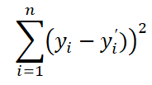

Training a single-neuron model
Introduction to Neural Network
x_{i1}
b_{k}
Step-1: Define the loss function
Step-2: Define the optimization
W_{k1}
x_{i2}
W_{k2}
∑
V_{k}
Activation Function
x_{i3}
W_{k3}
y’_{k}
:
:
:
W_{kd}
K^{th} Neuron
x_{id}
V_{k}= ∑_{j=1}^{d} (W_{kj}*x_{ij}) + b_{k}
y’_{k}= f(V_{k}) L= ∑_{i=1}^{n} (y_{i} - f(w^{T}x_{i} +b)²
Step-3Solve the Optimz Problem

Slide 27
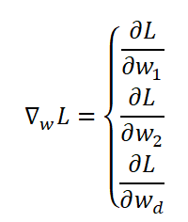


Training a single-neuron model
Introduction to Neural Network
x_{i1}
b_{k}
V_{k}= ∑_{j=1}^{d} (W_{j}*x_{ij}) + b_{k}
y’_{k}= f(V_{k})
Step-3: Solve the optimization problem
Randomly initialize the weights
Feed forward the inputs and compute the loss function
Update the weights
W₁
x_{i2}
W₂
L=(y-y’)²
∑
V_{k}
Activation Function
x_{i3}
W₃
y’_{k}
:
:
:
W_{n}
x_{in}
-2(y-y’))
-2(y-y’)*x
x
Types of ANN

Slide 28
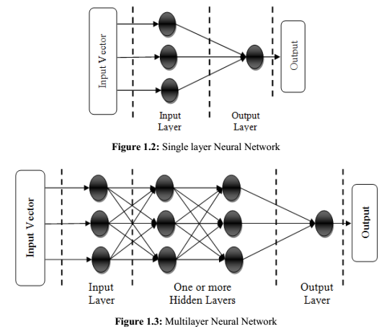
Types of Neural Network
Introduction to Neural Network
Why Multilayer ANN?

Slide 29
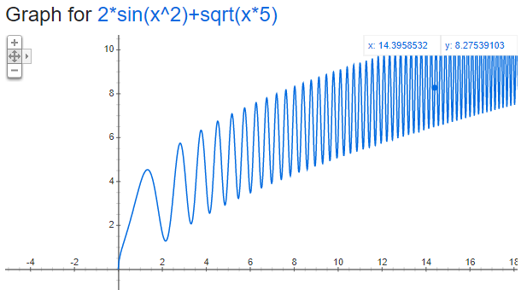
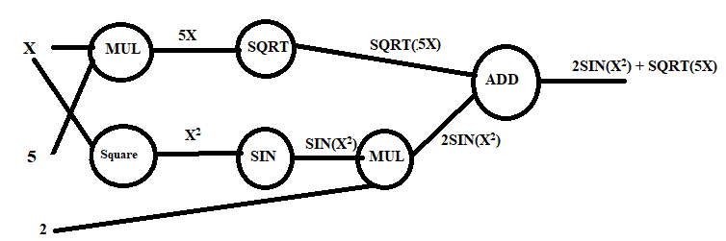
Why Multilayer Neural Network?
Introduction to Neural Network
Biological Inspiration
Universal Approximators: Can approximate any nonlinear function to any desired level of accuracy.
Results in Powerful Models
Feed Forward VS Recurrent ANN

Slide 30
Training Multilayer Neural Network
Introduction to Neural Network
Back-Propagation: Chain Rule + Memoization
In Stochastic Gradient Descent (SGD) U take one point (Input Vector)
In Mini-Batch SGD, U take a set of points(input vectors)
In Gradient Descent, U take all the input vectors
Sample labeled data
Randomly Initialize the Weights
Forward it through the network, get predictions
Back-propagate the errors
Update the network weights
Deep Learning

Slide 31
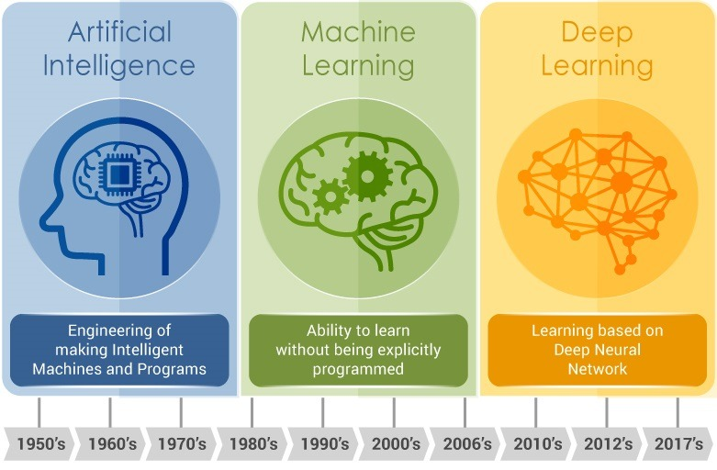
AI vs Machine Learning vs Deep Learning
Introduction to Neural Network
Formal Definition of DL

Slide 32
Deep Learning
Introduction to Deep Neural Network
A type of machine learning based on artificial neural networks in which multiple layers of processing are used to extract progressively higher level features from data.
- “Deep Learning with Python” Francois Chollet
DL Approach for solving problems

Slide 33
Deep Learning Approach
Introduction to Deep Neural Network
Standard Approach (Mathematicians)
Build new theories
Perform Experiments
New Deep Learning (Engineers way)
Given huge amount of computational power
People First Experiment and then try to build a theory
Why DL? Why now?

Slide 34
Why Deep Learning ? Why Now ?
Introduction to Deep Neural Network
Computer Vision- Convolutional Neural Networks and Backpropagation —well understood since 1989
Time Series Forecasting- Long Short-Term Memory — well understood since 1997
- “Deep Learning with Python” Francois Chollet
Why DL? Why now?

Slide 35

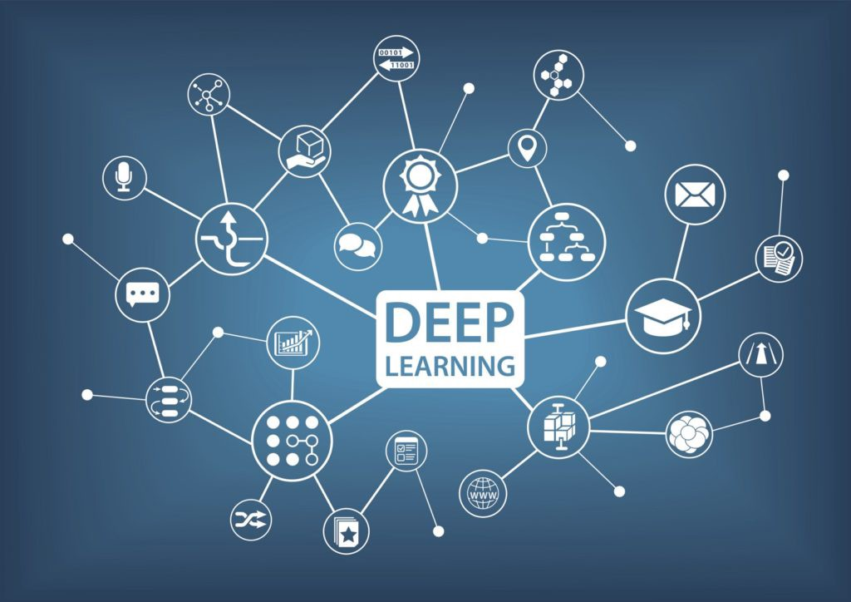
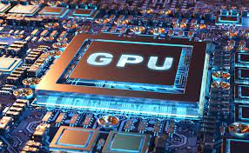
Why Deep Learning ? Why Now ?
Introduction to Deep Neural Network
Algorithmic
Advancements
Hardware
Advancements
Algorithmic Advancements…

Slide 36
Algorithmic Advancements…
Introduction to Deep Neural Network
Better Activation Functions for neural layers.
Better Weight Initialization Schemes starting with layer-wise pretraining.
To avoid Overfitting the Concepts like Dropout is Introduced.
Better optimization schemes, such as RMSProp and Adam.
Activation Functions

Slide 37
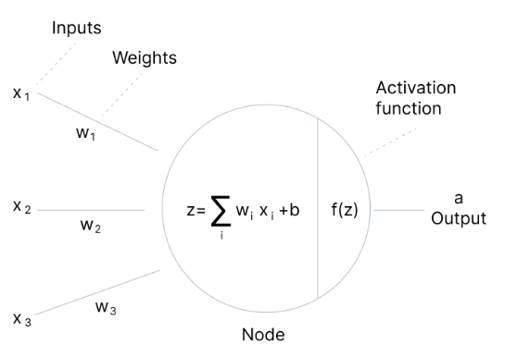
Activation Functions…
Introduction to Deep Neural Network
An Activation Function (Transfer Function) maps the weighted summation of inputs to output.
An Activation function is used to add Nonlinearity so that the network can learn complex patterns.
Sigmoid Activation Function

Slide 38
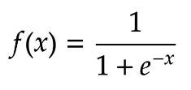
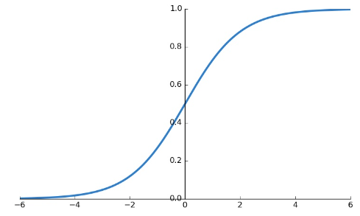
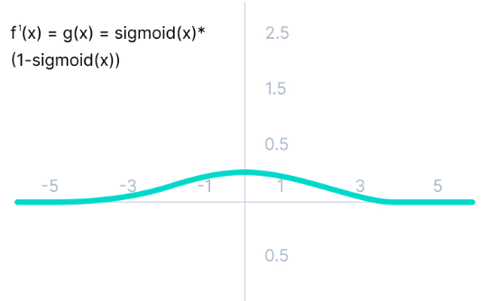
Sigmoid Activation Functions
Introduction to Deep Neural Network
Characteristics:
Differentiable
Nonlinear
O/P lies in [0-1]
Fast
Vanishing Gradient
Problem
Vanishing Gradient Problem

Slide 39
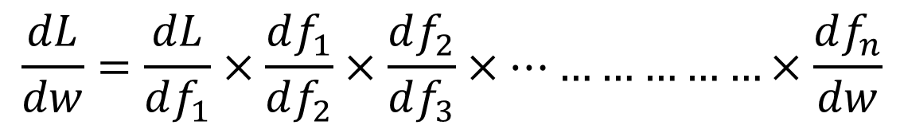
Vanishing Gradient problem
Introduction to Deep Neural Network
Because of sigmoid activation function the derivative is less than 1 and when the derivatives are multiplied it gives a very small number which ultimately changes the weight very less.
Usually occurs when the derivative is less than 1.
In case of sigmoid and tanh activation function it occurs frequently.
$$\frac{dL}{dw}=\frac{dL}{df_{1}}×\frac{df_{1}}{df_{2}}×\frac{df_{2}}{df_{3}}×………………×\frac{df_{n}}{dw}$$
ReLU Activation Function

Slide 40
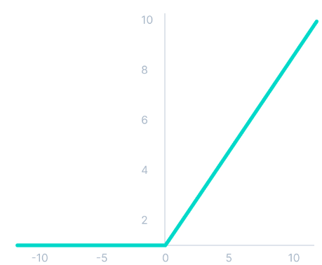

ReLU Activation Function
Introduction to Deep Neural Network
f(x)= x, when x>0
= 0, when x<=0
Avoids Vanishing Gradient Problem.
Derivative is Simple
f’(x)= 1 for x>=0
= 0 for x<0
Problem:
Dead ReLU Units
Leaky Relu Act Fun

Slide 41
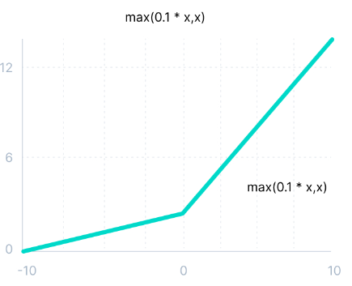

Leaky ReLU Activation Function
Introduction to Deep Neural Network
f(x)= x, when x>0
= 0.1x, when x<=0
The advantages of Leaky ReLU are same as that of ReLU.
In addition, it enables Backpropagation, even for negative input values.
Avoids Dead ReLU
Simple Derivative
f’(x)= 1 for x>=0
= 0.1 for x<0
Motivation for Weight Initia..

Slide 42
Weight Initialization
Introduction to Neural Network
Error----→
Weights----→
Weights----→
Used Rules Weight Initialization

Slide 43
Weight Initialization
Introduction to Deep Neural Network
Mostly used
We should never initialize to same values.
Asymmetry is necessary
We should not initialize to large –ve values
Vanishing Gradient problems
Weights should be small (not too small)
Weights should have good variance
Weights should come from a Normal distribution with mean zero and small variance
Should have some +ve and Some –ve values
Weight Initialization- Fan-in Fan-out

Slide 44
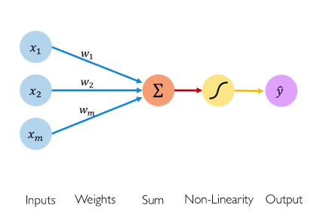
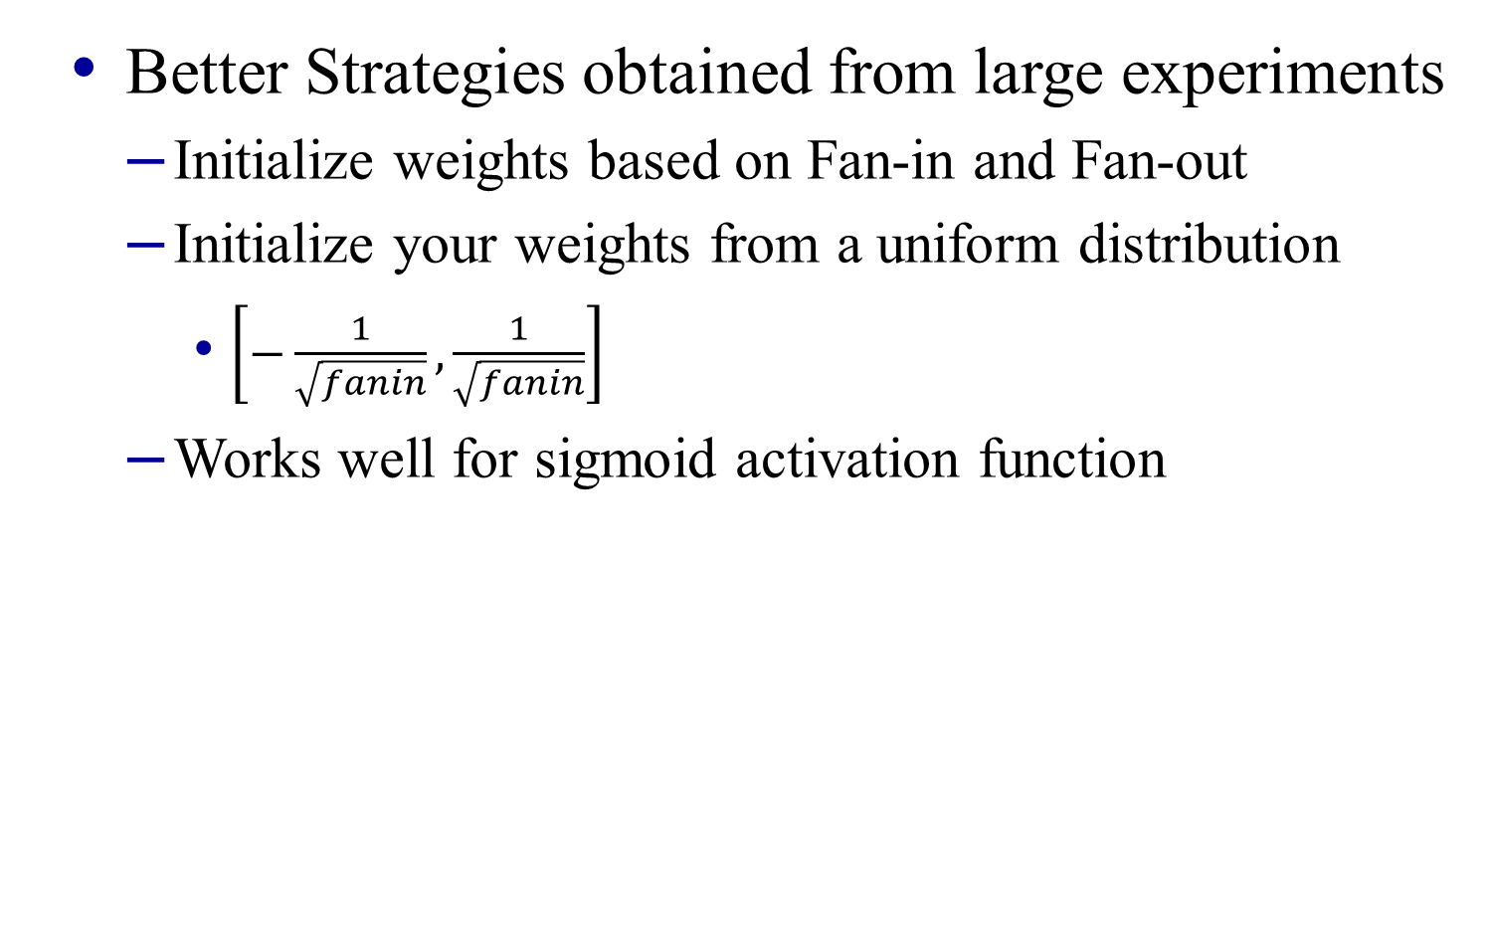
Weight Initialization
Introduction to Deep Neural Network
Better Strategies obtained from large experiments
Initialize weights based on Fan-in and Fan-out
Initialize your weights from a uniform distribution
$\left[−\frac{1}{\sqrt{fanin}},\frac{1}{\sqrt{fanin}}\right]$
Works well for sigmoid activation function
Neuron
Xavier Glorot Weight Initialization

Slide 45


Weight Initialization
Introduction to Deep Neural Network
Xavier/Glorot initialization in 2010- well for sigmoid activation function
First Variation –
Second Variation–
He Weight Initialization

Slide 46
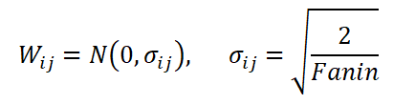

Weight Initialization
Introduction to Deep Neural Network
He Initializer, 2015 works well for ReLU
First Variation –
Second Variation–
Bias/Variance T/O Weight Initializ

Slide 47
Bias-Variance Trade-off
Introduction to Neural Network
No. of Layers Increases
More No. of Weights
Chances to Overfit is High
Problem of High Variance
Multilayer ANN has higher chance of overfitting.
No. of Layers Decreases
Less No. of Weights
Chances to Underfit is High
Problem of High Bias
Dropout and Regularization

Slide 48
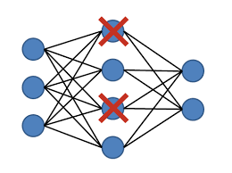
Dropout and Regularization
Introduction to Deep Neural Network
Deep NN tend to overfit because of many layers and weights
For this dropout and regularization is needed
In Dropout, a certain percentage of inputs and hidden layer neurons are dropped out for an iteration
Some call it as drop out network or layer.
‘
Dropout Procedure

Slide 49
Dropout
Introduction to Deep Neural Network
Procedure:
During training we decide with probability p to update a node’s weights or not.
We set p to be typically 0.5
Highly effective in deep learning:
Decreases overfitting
Reduces training time
Can be loosely interpreted as ensemble of networks
‘
Batch Normalization

Slide 50



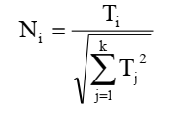

Batch Normalization
Introduction to Deep Neural Network
Normalization is a data pre-processing tool used to bring the numerical data to a common scale without distorting its shape.
Decimal Scaling:
Median:
Min-Max:
Vector:
Z-Score:
Motivation for Batch Normalization

Slide 51
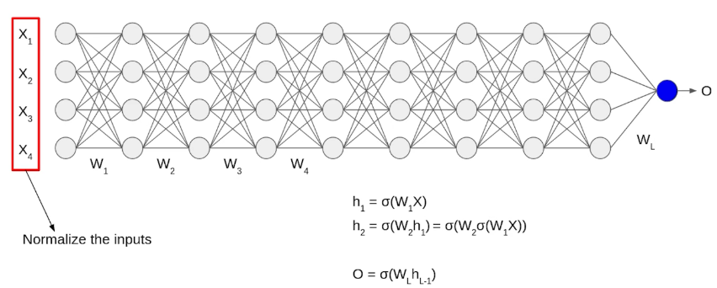
Batch Normalization
Introduction to Deep Neural Network
Motivation
Procedure of Batch Normalization

Slide 52


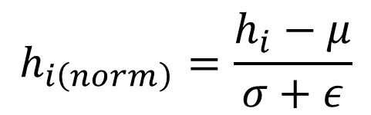


Batch Normalization
Introduction to Deep Neural Network
Where m: Number of Neurons at h_{i}
Where $γ$ and $β$ are hyper parameters.
$$μ=\frac{1}{m}\sum{h_{i}}$$
$$σ=\sqrt{\frac{1}{m}\sum{{\left(h_{i}−μ\right)}^{2}}}$$
$$h_{i\left(norm\right)}=\frac{h_{i}−μ}{σ+ε}$$
$$h_{i}=γ.h_{\left.i(norm\right)}+β$$
Advantages of Batch Normalization

Slide 53
Batch Normalization
Introduction to Deep Neural Network
Advantages
Faster Convergence
Weak Regularizer (Batch Normalization + dropout)
Avoids internal covariate shift
https://arxiv.org/pdf/1502.03167v3.pdf
Batch
Normalization
Optimizers

Slide 54
Optimizers
Introduction to Deep Neural Network
At minima, maxima and saddle point, u have the gradient as Zero.
Error----→
Weights----→
Weights----→
Convex and Non-Convex Error Fun

Slide 55
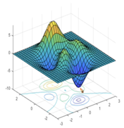
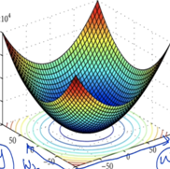
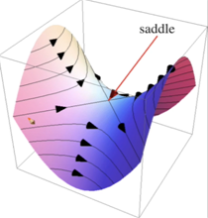
Optimizers
Introduction to Deep Neural Network
Convex function and Non-Convex Function
Convex functions have either 1 maxima or minima. (Local minima=global minima)
Non-convex functions have more than one minima or maxima
Stochastic Gradient Descent

Slide 56

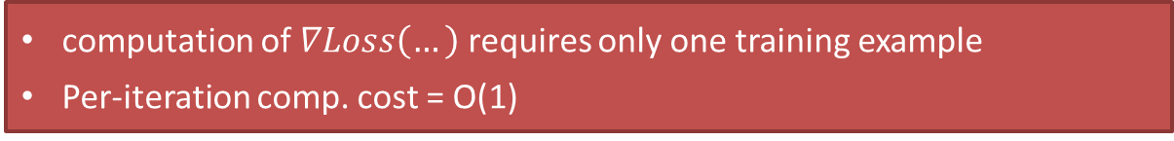
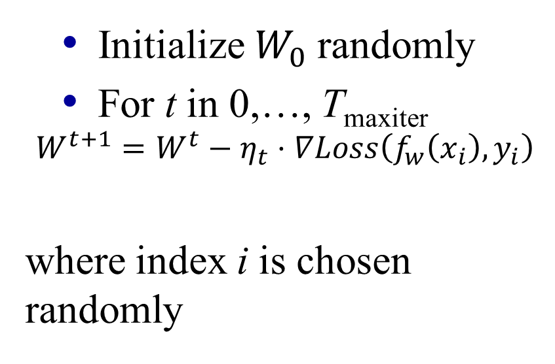



Stochastic gradient descent (SGD)
Introduction to Neural Network
You take one point (Input Vector), Feed Forward it then update the weights by back-propagating the gradient of errors.
$$W_{t+1}$$
$$W_{t}$$
Initialize $W_{0}$ randomly
For t in 0,…, T_{maxiter}
$$W^{t+1}=W^{t}−η_{t}⋅∇Loss\left(f_{w}\left(x_{i}\right), y_{i}\right)$$
where index i is chosen randomly
$$Wfinal$$
$$W0$$
Stochastic gradient
computation of $∇Loss\left(…\right)$ requires only one training example
Per-iteration comp. cost = O(1)
Gradient Descent

Slide 57
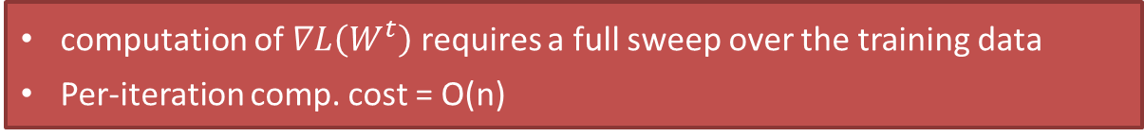

Gradient descent
Introduction to Neural Network
You take all Input Vectors, Feed Forward it one by one, compute the error and get the mean error, then update the weights by back-propagating the gradient of errors.
$$W_{t+1}$$
$$W_{t}$$
Initialize $W_{0}$ randomly
For t in 0,…, T_{maxiter}
$$W^{t+1}=W^{t}−η_{t}⋅∇L\left(f_{w}\left(x_{i}\right), y_{i}\right)$$
$$Wfinal$$
$$W0$$
Gradient of the objective
computation of $∇L\left(W^{t}\right)$ requires a full sweep over the training data
Per-iteration comp. cost = O(n)
Mini-Batch Stochastic Gradient Descent

Slide 58


Minibatch stochastic gradient descent
Introduction to Neural Network
You take a subset of Input Vectors (more than one), Feed Forward it one by one, compute the error and get the mean error, then update the weights by back-propagating the gradient of errors.
$$W_{t+1}$$
$$W_{t}$$
Initialize $W_{0}$ randomly
For t in 0,…, T_{maxiter}
$$W^{t+1}=W^{t}−η_{t}⋅{\tilde{∇}}_{B}L\left(W\right)$$
where minibatch B is chosen randomly
$$Wfinal$$
$$W0$$
minibatch gradient
$\tilde{∇}L\left(θ\right)$is average gradient over random subset of data of size B
Per-iteration comp. cost = O(B)
What actually doing in Training ANN

Slide 59

Stochastic Gradient with Momentum
Introduction to Deep Neural Network
The rate of convergence of Stochastic Gradient can be improved by adding a momentum to the Gradient expression.
This can be achieved by adding a fraction of previous weight change to the current weight change.
Momentum
Learning
Rate
Nastrove Accelerated Gradient

Slide 60
Nestrov Accelerated Gradient (NAG)
Introduction to Deep Neural Network
SGD + Momentum
Momentum
Gradient+Momentum
Gradient
What we r doing in NAG?

Slide 61
Nestrov Accelerated Gradient (NAG)
Introduction to Deep Neural Network
NAG
Gradient
Momentum
Gradient+Momentum
Visual Illustration of Advantage of NAG

Slide 62

Nestrov Accelerated Gradient (NAG)
Introduction to Deep Neural Network
AdaGrad

Slide 63
Adaptive Gradient(AdaGrad)
Introduction to Deep Neural Network
In SGD, SGD+Momentum and NAG, the learning rate is same for each weight.
However, in Adagrad you have different learning rate for different weights.
Why
Sparse Feature
Dense Feature
Mathematical formulation of AdaGrad

Slide 64


Adaptive Gradient(AdaGrad)
Introduction to Deep Neural Network
SGD
Adagrad
As iteration increases the learning rate decreases.
$$α_{t−1}=\sum_{i=1}^{t−1}{{{\left(\frac{dL}{dw}\right)}_{i}}^{2}}$$
Visual Illustn of why AdaGrad is Better

Slide 65
Adaptive Gradient(AdaGrad)
Introduction to Neural Network
Error----→
Weights----→
Weights----→
Pros & Cons of AdaGrad

Slide 66
Adaptive Gradient(AdaGrad)
Introduction to Deep Neural Network
Advantages
No need of manual tuning
Works well for both Sparse and Dense Feature
Disadvantages
As iteration increases, the learning rate will get low, which will result in Slow Convergence.
Computationally expensive.
AdaDelta to overcome slow Conveg

Slide 67


AdaDelta
Introduction to Deep Neural Network
${EDA}_{t−1}$= $γ$* ${EDA}_{t−1}+\left(1−γ\right){{\left(\frac{dL}{dw}\right)}_{t−2}}^{2}$
Avoids the Problem of slow convergence of AdaGrad
$$η_{t}^{′}=\frac{η}{\sqrt{{Exponentially Decaying\left(α\right)}_{t−1}+ε}}$$
Further improve Convgence RMSProp

Slide 68
Root Mean Square Propagation (RMSProp)
Introduction to Deep Neural Network
It is same to AdaDelta however, it discards the history from extreme past while computing the exponentially decaying average.
Converges faster once it finds a locally convex bowl as its error function.
Faster convergence than AdaDelta.
ADAM

Slide 69

Adam(Adaptive Momentum Estimation)
Introduction to Deep Neural Network
https://arxiv.org/pdf/1412.6980.pdf
Momentum is adaptive
Choice of Optimizer

Slide 70
Which Optimizer To Use
Introduction to Deep Neural Network
MiniBatch-SGD:::::::: Small/Shallow ANN
Momentum & NAG::: Works well in most cases but Slower
AdaGrad::::::::::::::::::: Sparse Features
AdaDelta & RMSProp: Preferred Over AdaGrad
Adam::::::::::::::::::::::: Most Favorite
How to Train Deep Neural Network

Slide 71
How to Train a Deep Neural Network?
Introduction to Deep Neural Network
Pre-processing: Data Narmalization
Weight Initialization
Xavier & Glorot (For Sigmoid)
He Initializer (For ReLU)
Choose the Activation Function (ReLU-Most Favourite)
Batch Normalization (Especially for later layers close to O/P Layer)
Use Dropout
Choose the Optimizer (Favourite- Adam)
Hyper-parameters: Architecture(# Layers, # Neurons), etc…
Loss Function
2-Class Classification : Log Loss
Multi-Class Classification: Multi-Class Log Loss
Regression: Squared Loss
Google Colab

Slide 72
Google Colab
Introduction to Deep Neural Network
colab.research.google.com
Playground for Tensorflow

Slide 73
Decision surfaces: Playground
Introduction to Deep Neural Network
http://playground.tensorflow.org/
Big Question

Slide 74
Big Questions?
Introduction to Deep Neural Network
How many Inputs?
How many Layers?
How many neurons in each layer?
Which Activation Function?
Which Kernel Initializer?
Which Optimizer?
What is the Batch Size?
What is the Learning Rate?

Slide 75
Solution
Introduction to Deep Neural Network
Grid Search
Bayesian Optimization
Swarm and Evolutionary Algorithms
Swarm & Evolutionary Soln…

Slide 76
Possible Solutions
Introduction to Deep Neural Network
Grid Search
Inappropriate to handle continuous valued hyper-parameters like learning rate, dropout rate, etc.
Suffers from dimensionality issues when the number of hyper-parameters to tune becomes large.
Bayesian Optimization
Inappropriate to handle discrete valued hyper-parameters like activation function, kernel initializer, batch size, number of neurons in each layer, etc.
Suffers from dimensionality issues when the number of hyper-parameters to tune becomes large.
Swarm and Evolutionary Algorithms
Can handle both continuous valued and discrete valued hyper-parameters.
Scalable.
e.g on Swarm & Evo. Algo Opt DL

Slide 77

Possible Solutions…
Time Series Forecasting
Grid Search
Bayesian Optimization
Swarm and Evolutionary Algorithms

Slide 78

Swarm and Evolutionary Algorithm Optimized DL Models
Introduction to Deep Neural Network
Reference | Deep Learning Model | Hyper-Parameters | Optimization Technique | Encoding Scheme | Application
[1] | CNN | Dropout rate, Number of epochs, Number of filters, Number of outputs of each layer, Optimizer, Batch Size, Steps taken between pooling, , Size of Pooling, Layer type, Activation function, Initialization function, Rows and columns of the kernel, including bias, Behaviour of operator at the border. | Evolutionary Algorithm (EA) | Variable-length real encoding | Image Classification
[2] | CNN | Number of epochs, Contraction Expansion coefficient, measure times, Batch Size. | Particle Swarm Optimization (PSO) | Fixed-length binary encoding | Image Classification
[3] | CNN | Dropout rate, Kernel Size, No. of epochs, Batch Normalisation. | PSO | Variable-length real encoding | Image Classification
[4] | DNN, LSTM-RNN, DBN | Batch Size, Learning Rate, Type of Layer, Initialization function, Optimizer, Number of epochs, Dropout rate, Decay rate, Momentum. | PSO | Fixed-length binary encoding | Network Intrusion Detection
[5] | CNN | Dropout rate, Activation function, Kernel Initializer, Learning Rate, Batch Size. | PSO | Fixed-length hybrid binary encoding | Image Classification
[6] | CNN | Size of the mini-batch, dropout rate. | PSO | Fixed-length real encoding | Image Classification
[7] | CNN | Dropout rate, Dropout rate for $lth$ block, Number of units in the dense layers, Momentum, Batch size, Number of epochs, Number of filters, Learning rate, Weight decay. | Fractal Decomposition Algorithm (FDA) | Fixed-length real encoding | Image Classification

Slide 79
Swarm and Evolutionary Algorithm Optimized DL Models
Introduction to Deep Neural Network
Reference | Deep Learning Model | Hyper-Parameters | Optimization Technique | Encoding Scheme | Application
[8] | CNN | Learning Rate, Channels, Weight decay, Nesterov, Momentum, Optimizer, Batch Size, Number of epochs. | EA | Fixed-length real encoding | Image Classification
[9] | RNN | Activation function, Net input function, Learning Methods, Model of neuron, Number of neurons in output layer. | Genetic Algorithm (GA) + Gradient Descent Method | Fixed-length real encoding | Nuclear Reactor
[10] | CNN | Batch size, number of epochs, optimizer type, momentum rate, learning rate, dropout rate, activation function type, Number of convolutional layers, Number of filters, Convolution filter size, maxpooling size. | Cat Swarm Optimization (CSO) | Variable-length real encoding | Image Classification
[11] | CNN | Number of neurons in each convolutional layer, Number of convolutional layers. | PSO | Fixed-length binary encoding | Image Classification
[12] | CNN | Number of neurons in an Fully Connected layer, Pool type, Pool stride size, Pool kernel size, Convolution kernel size, Convolutional stride size, Length of CNN, number of feature maps. | Differential Evolution (DE) | Variable-length real encoding | Image Classification
[13] | CNN | Number of blocks, Number of nodes, Number of filters, Filter size, Pooling, Dropout, short connection, Batch normalization, Type of layer, Activation function, Dropout, Optimizer, Learning rate, Batch size, Initialization, Number of convolution layers, Activation function. | GA | Fixed-length Block-Based encoding | Image Classification
[14] | CNN | Dropout rate, Weight initialization method, Activation function, Kernel Initializer, Position of BN, BN Control parameter, No. of Hidden Nodes, No. of convolutional kernel | GA | Variable-length Block-Based encoding | Image Classification

Slide 80
Swarm and Evolutionary Algorithm Optimized DL Models
Introduction to Deep Neural Network
Reference | Deep Learning Model | Hyper-Parameters | Optimization Technique | Encoding Scheme | Application
[15] | BiLSTM | No. of epochs of BP, learning rate, Number of iterations, maximum epochs of BiLSTM, Number of hidden neurons. | Improved Sine Cosine Algorithm (ISCA) | Fixed-length real encoding | Wind Speed Prediction
[16] | CNN/RNN/GRU/LSTM | Network type, Weight value, Number of CNN layers, Kernel size of CNN, Whether bidirectional of the recurrent neural network, Number of layers of the recurrent neural network, Number of hidden nodes of the recurrent neural network. | GA | Variable-length real encoding | Time Series Forecasting
[17] | CNN | Learning Method, momentum rate, weight decay, drop path probability. | EA | Fixed-length real encoding | Image Classification
[18] | CNN | Batch size, epochs, SGD learning rate, momentum. | EA | Fixed-length binary encoding Variable-length real encoding | Image Classification
[19] | CNN | Learning rate for individual evaluation and fine-tuning, Number of epochs for individual evaluation and fine tuning. | EA | Variable-length binary encoding | Image Classification
[20] | CNN | Number of filters of Conv1D, Pool Size, Dropout rate, Optimizer. | EA | Variable-length real encoding | Image Classification

Slide 81
Limitation in Literature of Optimizing DL Models
Introduction to Deep Neural Network
Hyper-parameters of DL models used for optimization
Number of neurons in each layer [9, 11, 12, 15-16]
Activation function [1, 5, 9-10, 13-14]
Learning rate [4-5, 7-8, 10, 13, 15, 18-19]
Batch size [1-2, 4-5, 7-8, 10, 13, 18]
Dropout rate [1, 3-7, 10, 14, 20]
Kernel initializer (weight initialization scheme) [3, 5, 14, 16].
Encoding Scheme
Fixed-length (Drawback: Can’t encode DL models with varying layers and not flexible)
Binary [2, 4-5, 11, 18]
Real [6-9, 17-18]
Block [13]
Variable-length (Drawback: Complex implementation and high computational overhead)
Binary [19]
Real [1, 3, 10, 12, 16, 18, 20]
Block [14]
Number of Layers are not optimized
Applicable to a specific DL model

Slide 82
Overcoming the Limitations in Literature of Optimizing DL Models
Introduction to Deep Neural Network
Ref: Sourav Kumar Purohit and Sibarama Panigrahi, Novel Deterministic and Probabilistic Forecasting Methods for Crude Oil Price Employing Optimized Deep Learning, Statistical and Hybrid Models. Information Sciences Journal, 120021, 2024. (Elsevier, Impact Factor: 8.1)
DOI: https://doi.org/10.1016/j.ins.2023.120021
Hyper-parameters of DL models used for optimization
Number of neurons in each layer
Activation function
Learning rate
Batch size
Dropout rate
Kernel initializer (weight initialization scheme)
Encoding Scheme
Proposed fixed-length Real Encoding Scheme with pruning method which has the simplicity of fixed-length encoding scheme with flexibility of variable-length encoding scheme.
Optimization Algorithm: Differential Evolution (DE)
Applicable to a optimize different DL model (LSTM, CNN, GRU, BiLSTM, ConvLSTM)

Slide 83
Possible Solutions…
Time Series Forecasting
Grid Search
Bayesian Optimization
Swarm and Evolutionary Algorithms

Slide 84


Optimizing DL Models using Swarm and Evolutionary Algos
Introduction to Deep Neural Network
Encoding a DL Model to a Chromosome $(C_{i})$
Objective Function:
$$\min_{C_{i}}{f(C_{i})}$$
Subjected to ${L_{j}≤C}_{i,j}≤U_{j}$
where $f(∙)$ denotes the mean square error using the DL Model with hyper-parameters encoded in $C_{i}$.

Slide 85

Optimizing DL Models using Swarm and Evolutionary Algos
Introduction to Deep Neural Network
Decoding a Chromosome
Decoding a Kernel Initializer

Slide 86

Optimizing DL Models using Swarm and Evolutionary Algos
Introduction to Deep Neural Network
Decoding a Chromosome
Decoding a Decision Vector to DL

Slide 87

Decoding a Chromosome (Decision Vector) to a DL Model
Introduction to Deep Neural Network
Combining all

Slide 88
Possible Solutions…
Time Series Forecasting
Grid Search
Bayesian Optimization
Swarm and Evolutionary Algorithms

Slide 89
Thank You
For Your Valuable Time.

